Slide 1

GuardShield AI
Real-time prompt-injection defence and hallucination detection for LLM apps — and what happens to injection detectors when text looks unfamiliar
Shourya Solanki · Rachit Ryan Chug · Dhruv Raj Singh
Guide: Dr. Abhishek Kaushal (ACAI) · B.Tech CSE (AI & ML), ASET · Amity University Uttar Pradesh
Notes:
GuardShield AI is an open safety layer for applications built on large language models. It does two things: it stops prompt-injection attacks before they reach the model, and it catches hallucinated answers before they reach the user. Testing it led to our research paper on how injection detectors behave when the input is disguised.

Slide 2




One proxy, three checks
Your app
Stage 1 · injection scan
LLM + entropy monitor
Stage 2 · fact check
Safe answer
Sends chat requests exactly as before
DeBERTa-v3 classifier blocks attacks before the model sees them
Watches uncertainty token by token; halts on repeated spikes
NLI model checks the answer against the evidence
Delivered, corrected, or blocked
Drop-in sidecar: same OpenAI-compatible API, so the app only changes a URL. Signed assistant history, input-size cap, runs on a 4 GB laptop GPU.
Notes:
The app talks to GuardShield exactly as it would talk to the model. Stage 1, a fine-tuned DeBERTa-v3-small classifier, scores every prompt and rejects injections. While the model writes, an entropy monitor watches its uncertainty and stops generation after repeated spikes. Stage 2, a natural-language-inference model, checks the answer against the retrieved evidence: supported, contradicted or unverified.

Slide 3
Accurate and fast on clean text
98.6%
of attacks caught on the test set
0.58%
of harmless prompts wrongly blocked
26.5 ms
per prompt on a laptop GPU
Notes:
On held-out prompts Stage 1 catches 98.6% of attacks and blocks only 0.58% of harmless prompts, in 26.5 ms; the full pipeline takes 41.5 ms. On a zero-shot set of attacks it never saw, it still catches 97.2%, while the word-matching TF-IDF baseline collapses. But all of this is clean text.

Slide 4
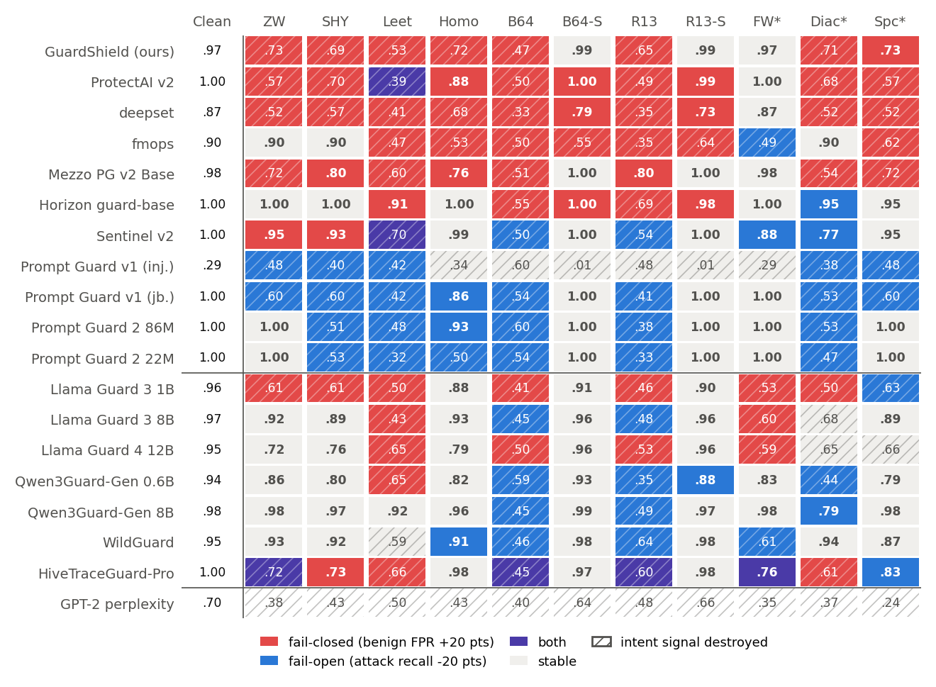
Disguised text breaks injection detectors
Paired audit: 500 attacks, each with a same-length harmless twin; both get the identical disguise (11 kinds) — 19 public detectors
55%
of detector–disguise cells can no longer tell attacks from harmless text
45%
of cells that look “robust” only because they block harmless text too
τ = 0.05
attack-only leaderboards do not predict real robustness
Notes:
Our own detector looked robust on disguised attacks, but it also blocked 97.8% of harmless prompts with soft hyphens. So we audited 19 detectors with a paired test: every attack has a harmless twin of the same length, and both get the same disguise. Red cells block harmless users (fail-closed), blue cells miss attacks (fail-open), hatching means the detector cannot separate the two at all. The result repeats on a second dataset: all 105 cells with a clear direction keep it.

Slide 5
Why it happens, and what fixes it
What the detector's tokenizer does to the disguise decides the outcome
Normalized away
17 of 17 intact
Turned into unknown tokens
4 of 4 destroyed
Split into fragments
53 of 98 destroyed
Unreadable input gets the detector's default verdict (94% of destroyed cells): that is why some fail closed and others open.
Notes:
Study 2 retrained GuardShield five times per option. Cleaning the input first with a script-aware canonicalizer raised the separation on a new attack source from 0.55 to 0.84; training on disguised copies (augmentation) reached only 0.62. Decoded Base64 must replace the original text: keeping the higher score left 100% of harmless wrapped prompts blocked, replacing it lowered that to 59%.

Slide 6


Takeaways
An open, fast safety layer
27 ms injection scan, 97% recall on unseen attacks, plus answer fact-checking
Attack-only tests mislead
45% of “robust” results come from blocking harmless users too
Clean the input before retraining
Canonicalization 0.55 → 0.84 AUROC on a new source; augmentation 0.62
Live demo: python -m streamlit run dashboard/app.py · Code: github.com/Shourya3113/GuardShield-AI
Notes:
Three things to remember. GuardShield is an open, fast safety layer that checks both what goes into the model and what comes out. Robustness tests that only perturb attacks reward detectors that block everything unusual. And the practical fix is to clean the input before retraining. Now let's see it live in the dashboard.

